Slide 1
Topic: Order of operations
EQ: How do we use BIMDAS?
Mental Arithmetic
Round 45632 to the nearest 1000
Round 0.0035 to 3 d.p
Round 4327 to the nearest 100
Round 5.62 to 1 d.p
Round 3.4528 to 2 d.p

Slide 2
You think you can just do your sums in any order you like? THINK AGAIN! Listen up!

Slide 3
Think about this sum-
=35?
3 + 4 x 5
Nope!
When lots of things happen in a sum we can’t go left to right. Try this sum
The correct answer is 23

Slide 4
24
7
30
Topic: BIMDAS
Date
EQ – How do we use BIMDAS?
What are the rules of BIMDAS?
Order of Operations / BIMDAS
1. Brackets First
2. Indicies
3. Multiply and/or Divide
(from left to right)
4. Add or Subtract
(from left to right)

Slide 5
Here are some examples of how to use BIMDAS
A good tip is to underline the bit you are going to do, then write the answer under your line, along with the rest of the sum.

Slide 6

B
I
D
M
A
S
(3
4)
x 2
+
x 2
=
7
=
14

Slide 7
B
I
D
M
A
S
3
3
4
x 2
+
+
=
8
=
11

Slide 8
B
I
D
M
A
S
4
4
x 3²
x
=
9
=
36

Slide 9
B
I
D
M
A
S
3
3
4
- 2
+
x 3
- 2
=
+
12
=
13

Slide 10
B
I
D
M
A
S
3
3
x
(5
2
x
2
- 2
- 3)
- 2
=
x
2
- 2
3
4
- 2
12
=
10

Slide 11
6 + 4 x 3 =
30
72
x
x
What do you think?

Slide 12
10 – 8 ÷ 2 =
6
1
x
What do you think?

Slide 13
1 + 4 x 3² =
145
37
x
What do you think?

Slide 14
20 - 4 + 10 =
26
6
x
What do you think?

Slide 15
3 + 4 x 3 + 1 = 19
( )
Tim’s sum is wrong
We can make it right be adding a pair of brackets. Where do they need to go?

Slide 16

24
7
30
Topic: BIMDAS
Date
EQ – How do we use BIMDAS?
What are the rules of BIMDAS?
Order of Operations / BIMDAS
1. Brackets First
2. Indicies
3. Multiply and/or Divide
(from left to right)
4. Add or Subtract
(from left to right)
Let’s Try…
2 + $6 ×\left(4+2\right) ÷3^{2}=$
2 + $6 ×6 ÷3^{2}=$
2 + $6 ×6 ÷9=$
2 + 4 =
6

Slide 17

24
7
30
Topic: BIMDAS
Date
EQ – How do we use BIMDAS?
What are the rules of BIMDAS?
Let’s Try…
$$\left(2^{3} −\left(3−3+2\right)\right)÷3 ×4=$$
$$\left(2^{3} −2\right)÷3 ×4=$$
$$\left(8 −2\right)÷3 ×4=$$
$$6÷3 ×4=$$
8
Order of Operations / BIMDAS
1. Brackets First
2. Indicies
3. Multiply and/or Divide
(from left to right)
4. Add or Subtract
(from left to right)
Inside brackets first

Slide 18
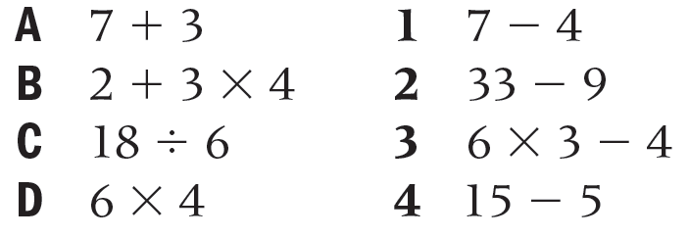
Match each of these calculations with one that gives the same answer.
Hint: work all of them out and then match them up

Slide 19
Answers
A = 10
B = 14
C = 3
D = 24
1 = 3
2 = 24
3 = 14
4 = 10

Slide 20
Bidmas
24
3
2
20
10
1
26
22
1
19
0
2
9
5
1
26
25
20
17
5
1
1
2
A)
(3 + 3 ) x 4
4 x 2 – 5
(5 + 7) ÷ 6
5 x 3 + 5
(9 – 4 ) + 5
1 + 1 – 1
2 x (15 – 2)
(5 x 4 ) + 2
(8 + 2 ) ÷ 10
(21 x 1 ) – 2
B)
(1 + 14) – (5 x 3 )
(10 + 6 ) ÷ (4 x 2)
(1 + 2 ) x (6 – 3)
(2 x 6 ) – (14 ÷ 2)
(7 x 2) ÷ ( 20 – 6)
(3 x 10) – (2 x 2)
(9 x 5) – ( 2 x 10)
C)
(3 x 3 – 4 ) x (2 + 2)
2 x (13 – 4) – (23 ÷ 23)
3 x (1 + 4) – (5 x 2)
4 x (3 + 2) – ( 24 – 5)
7 x ( 4 ÷ 2 ) ÷ ( 3 x 5 -1 )
((9 + 7 x 3 ) ÷ 10) – 1

Slide 21
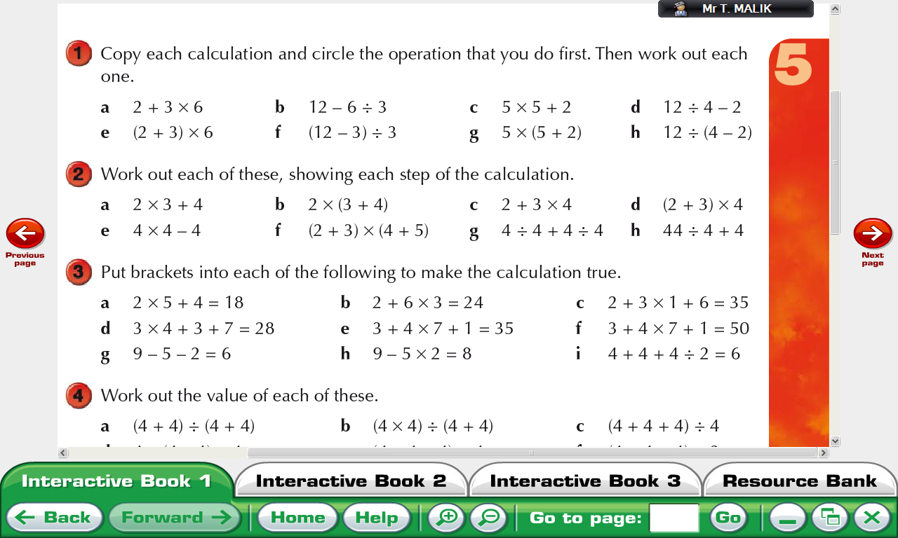

Slide 22
a 2 + 3 × 6 = 20
b 12 – 6 ÷ 3 = 10
c 5 × 5 + 2 = 27
d 12 ÷ 4 – 2 = 1
e (2 + 3) × 6 = 30
f (12 – 3) ÷ 3 = 3
g 5 × (5 + 2) = 35
h 12 ÷ (4 – 2) = 6

Slide 24
What is the secret message?
Start 27 2 + 2 x 4 | T 10 8 – 3 x 2 | T 8 5x7+6x9 | O 12 5 x 2 + 7
R 7 37 – 4 x 8 | D 26 (5 – 2) x 5 | E 18 6 x (9 – 7) | R 60 7 x 8 - 9
H 2 2 x (4 + 5) | T 6 64÷(5 + 3) | S 47 9 x (5 – 2) | M 5 (4 + 5) x 8
A 72 48 ÷ (6+2) | E 89 4x(3+2)x3 | R 17 3x4+2x7 | E 15 11x3-2x13
Notes:
Start with the box marked start. Find the answer to the problem, go to the box with this answer. Write down the letter in this box. Etc until you get back to start.
What is the secret message?
THE ORDER MATTERS

Slide 25
THEORDERMATTERS

Slide 26
a 10
b 14
c 14
d 20
e 12
f 45
g 2
h 15

Slide 27
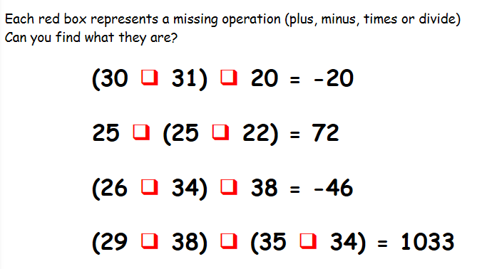
Missing Operations

Slide 28
(30 - 31) x 20 = -20
25 + (25 + 22) = 72
(26 - 34) - 38 = -46
(29 x 38) - (35 + 34) = 1033

Slide 29
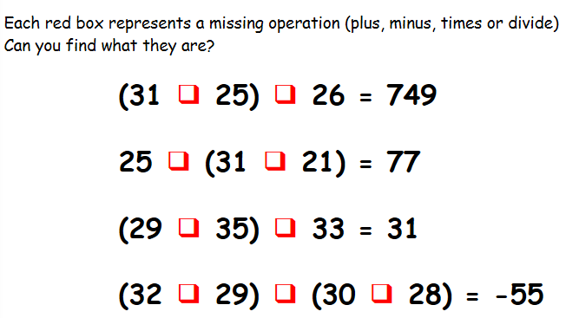
Again

Slide 30
(31 x 25) - 26 = 749
25 + (31 + 21) = 77
(29 + 35) - 33 = 31
(32 - 29) - (30 + 28) = -55

Slide 31
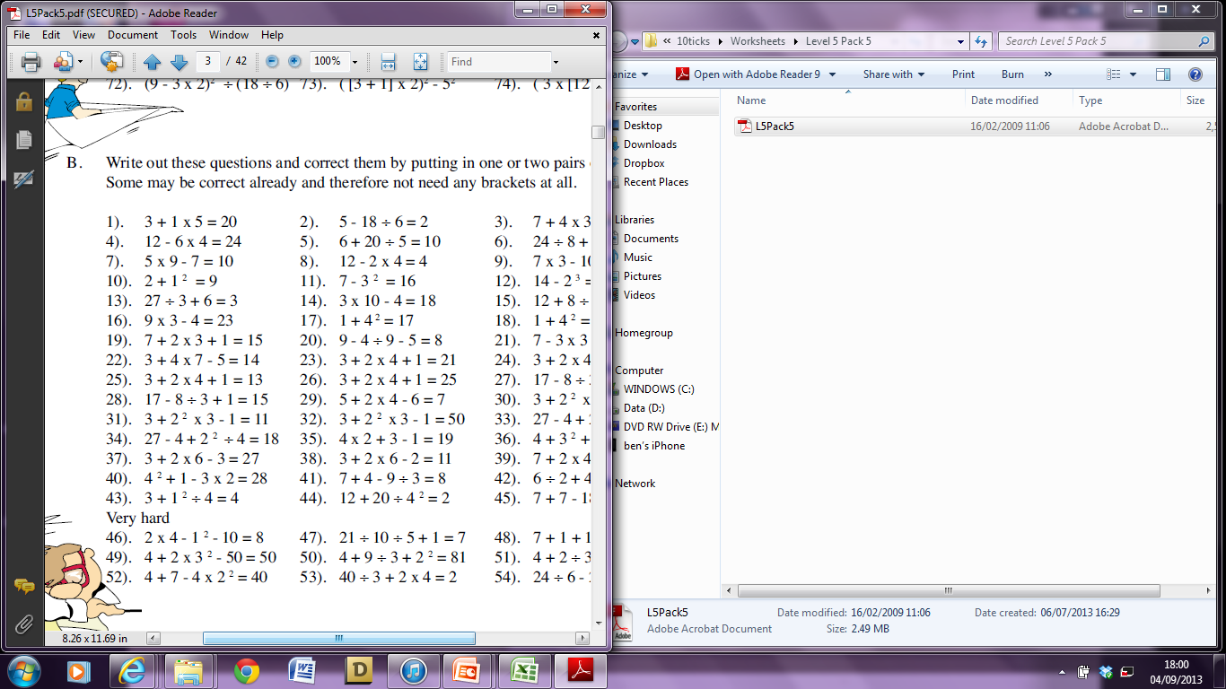
Where do we need to put the brackets?
Challenge Questions

Slide 32
Evaluate the following:
5 x 3 – 4
50 ÷ 5 x 3
Put the brackets in for the following to work:
36 ÷ 4 + 5 = 4
3 + 4 x 7 – 5 = 14
Evaluate the following:
7² + (4 – 9)
(9 ÷ 3) x 4²

Slide 33
Evaluate the following:
5 x 3 – 4 = 11
50 ÷ 5 x 3 = 30
Put the brackets in for the following to work:
36 ÷ (4 + 5) = 4
(3 + 4) x (7 – 5) = 14
Evaluate the following:
7² + (4 – 9) = 44
(9 ÷ 3) x 4² = 48

